Slide 2
Antra SEP Program
Introduction to Web
Advanced Java slide 1

Slide 3
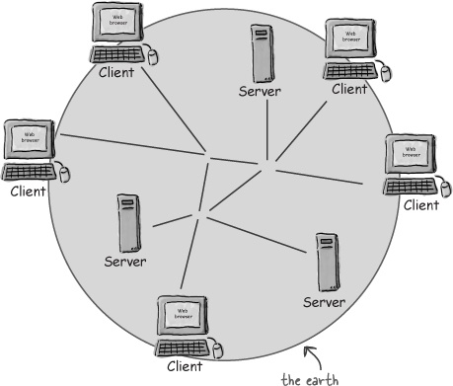
Internet Overview
The web consists of gazillions of clients (using browsers like Mozilla or Safari) and servers (using web server apps like Apache) connected through wires and wireless networks.

Slide 4
What does your web server do?
A web server takes a client request and gives something back to the client.
A web browser lets a user request a resource. The web server gets the request, finds the resource, and returns something to the user. Sometimes that resource is an HTML page. Sometimes it’s a picture. Or a sound file. Or even a PDF document. Doesn’t matter—the client asks for the thing (resource) and the server sends it back.
Unless the thing isn’t there. Or at least it’s not where the server is expecting it to be. You’re of course quite familiar with the “404 Not Found” error—the response you get when the server can’t find what it thinks you asked for.
When we say “server”, we mean either the physical machine (hardware) or the web server application (software). Throughout the book, if the difference between server hardware and software matters, we’ll explicitly say which one (hardware or software) we’re talking about

Slide 5
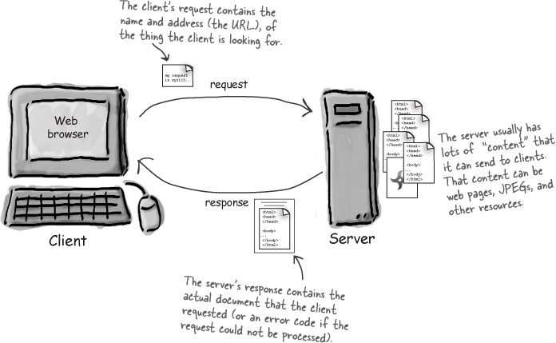
Client Server Overview

Slide 6
What does a web client do?
A web client lets the user request something on the server, and shows the user the result of the request.
When we talk about clients, though, we usually mean both (or either) the human user and the browser application.
The browser is the piece of software (like Netscape or Mozilla) that knows how to communicate with the server. The browser’s other big job is interpreting the HTML code and rendering the web page for the user.
So from now on, when we use the term client, we usually won’t care whether we’re talking about the human user or the browser app. In other words, the client is the browser app doing what the user asked it to do

Slide 7
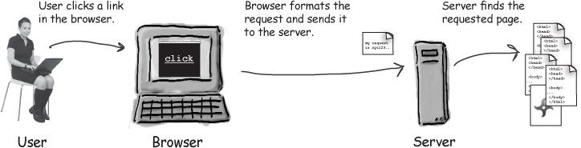
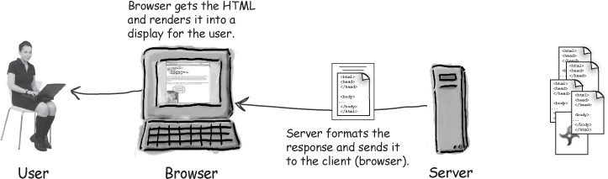
Client Server Overview

Slide 8
HTML
When a server answers a request, the server usually sends some type of content to the browser so that the browser can display it. Servers often send the browser a set of instructions written in HTML, the HyperText Markup Language. The HTML tells the browser how to present the content to the use
All web browsers know what to do with HTML, although sometimes an older browser might not understand parts of a page that was written using newer versions of HTML.

Slide 9
HTTP
Most of the conversations held on the web between clients and servers are held using the HTTP protocol, which allows for simple request and response conversations. The client sends an HTTP request, and the server answers with an HTTP response. Bottom line: if you’re a web server, you speak HTTP.
When a web server sends an HTML page to the client, it sends it using HTTP. (You’ll see the details on how all this works in the next few pages.)
(FYI: HTTP stands for HyperText Transfer Protocol.)
HTTP is the protocol clients and servers use on the web to communicate.
The server uses HTTP to send HTML to the client.

Slide 10
What is the HTTP protocol?
HTTP runs on top of TCP/IP. If you’re not familiar with those networking protocols, here’s the crash course: TCP is responsible for making sure that a file sent from one network node to another ends up as a complete file at the destination, even though the file is split into chunks when it’s sent. IP is the underlying protocol that moves/routes the chunks (packets) from one host to another on their way to the destination. HTTP, then, is another network protocol that has Web-specific features, but it depends on TCP/IP to get the complete request and response from one place to another. The structure of an HTTP conversation is a simple Request/Response sequence; a browser requests, and a server responds.

Slide 11
Key elements of the request stream:
HTTP method (the action to be performed)
The page to access (a URL)
Form parameters (like arguments to a method)

Slide 12
Key elements of the response stream:
A status code (for whether the request was successful)
Content-type (text, picture, HTML, etc.)
The content (the actual HTML, image, etc.)

Slide 13
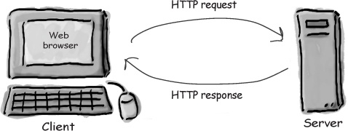
HTML is part of the HTTP response
An HTTP response can contain HTML. HTTP adds header information to the top of whatever content is in the response (in other words, the thing coming back from the server). An HTML browser uses that header info to help process the HTML page. Think of the HTML content as data pasted inside an HTTP response.

Slide 14
what’s in the request?
The first thing you’ll find is an HTTP method name. These aren’t Java methods, but the idea is similar. The method name tells the server the kind of request that’s being made, and how the rest of the message will be formatted. The HTTP protocol has several methods, but the ones you’ll use most often are GET and POST.

Slide 15
GET is a simple request, POST can send user data
GET is the simplest HTTP method, and its main job in life is to ask the server to get a resource and send it back. That resource might be an HTML page, a JPEG, a PDF, etc. Doesn’t matter. The point of GET is to get something back from the server.
POST is a more powerful request. It’s like a GET plus plus. With POST, you can request something and at the same time send form data to the server (later in this chapter we’ll see what the server might do with that data)
There are a few rarely used methods (and Servlets can handle them) including HEAD, TRACE, PUT, DELETE, OPTIONS, and CONNECT

Slide 16
Reasons you might use POST instead of GET include:
you can send a little data with HTTP GET
The total amount of characters in a GET is really limited (depending on the server). If the user types, say, a long passage into a “search” input box, the GET might not work.
The data you send with the GET is appended to the URL up in the browser bar, so whatever you send is exposed. Better not put a password or some other sensitive data as part of a GET!
Because of number two above, the user can’t bookmark a form submission if you use POST instead of GET. Depending on your app, you may or may not want users to be able to bookmark the resulting request from a form submission.

Slide 17
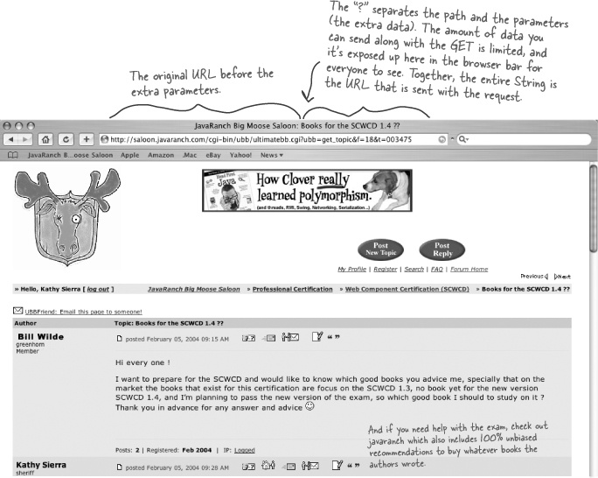

Slide 18
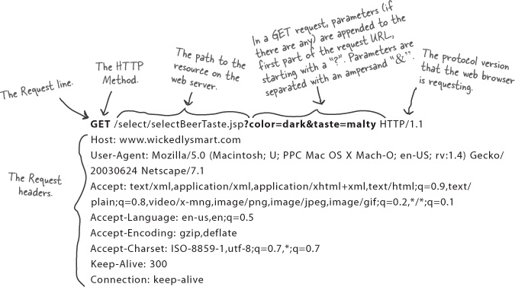
How Get Request Looks like?

Slide 19
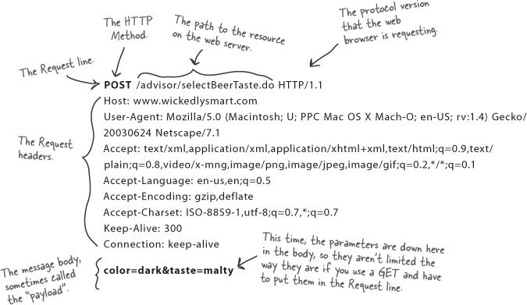
How Post looks like?

Slide 20
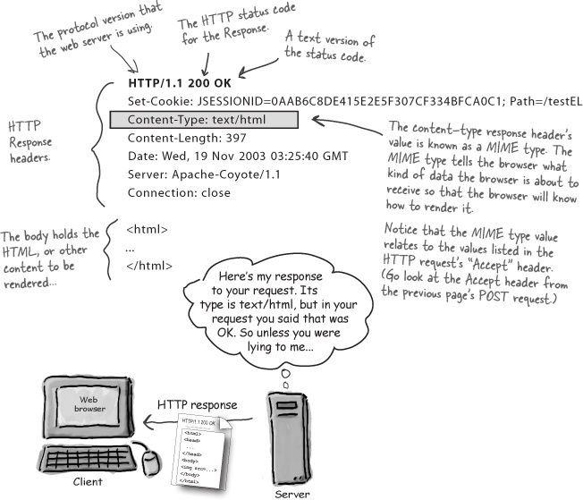
HTTP response

Slide 21
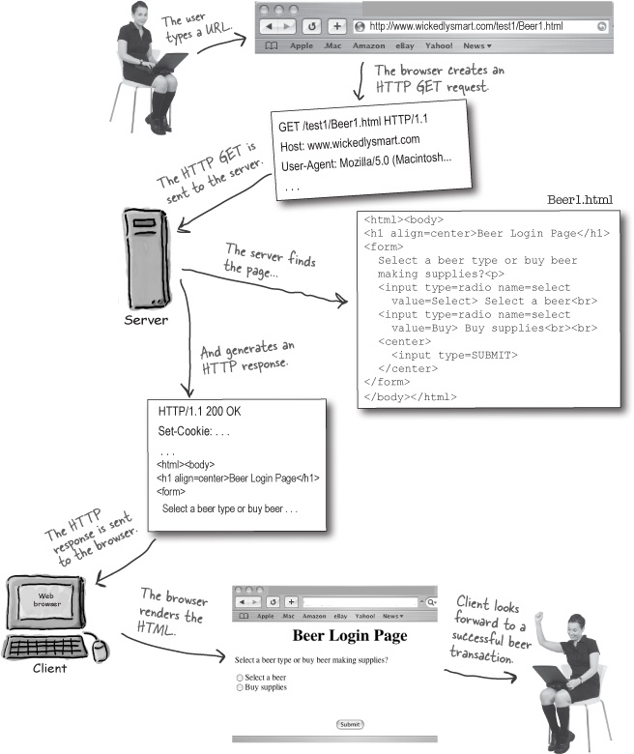

Slide 22
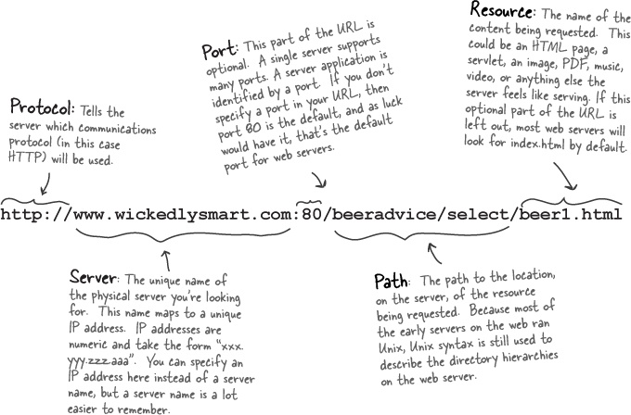
URL format.
URI, URL, URN? For now, we’re going to focus on the URLs, or Uniform Resource Locators. Every resource on the web has its own unique address, in the URL format.
if this was a GET request, the extra info (parameters) would be appended to the end of this URL, starting with a question mark “?”, and with each parameter (name/value pair) separated by an ampersand “&”.

Slide 23
A TCP port is just a number A 16-bit number that identifies a specific software program on the server hardware.
Your internet web (HTTP) server software runs on port 80. That’s a standard. If you’ve got a Telnet server, it’s running on port 23. FTP? 21. POP3 mail server? 110. SMTP? 25. The Time server sits at 37. Think of ports as unique identifiers. A port represents a logical connection to a particular piece of software running on the server hardware. That’s it. You can’t spin your hardware box around and find a TCP port. For one thing, you have 65536 of them on a server (0 to 65535). For another, they do not represent a place to plug in physical devices. They’re just numbers representing a server application.
Without port numbers, the server would have no way of knowing which application a client wanted to connect to. And since each application might have its own unique protocol, think of the trouble you’d have without these identifiers. What if your web browser, for example, landed at the POP3 mail server instead of the HTTP server? The mail server won’t know how to parse an HTTP request! And even if it did, the POP3 server doesn’t know anything about serving back an HTML page.
If you’re writing services (server programs) to run on a company network, you should check with the sys-admins to find out which ports are already taken. Your sys-admins might tell you, for example, that you can’t use any port number below, say, 3000.

Slide 24
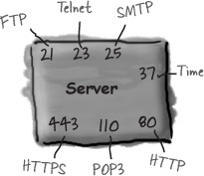
Tcp Port Numbers
Using one server app per port, a server can have up to 65536 different server apps running.
The TCP port numbers from 0 to 1023 are reserved for well-known services (including the Big One we care about—port 80). Don’t use these ports for your own custom server programs!

Slide 25
Directory structure for a simple Apache web site
We’ll talk more about Apache and Tomcat later, but for now let’s assume that our simple web site is using Apache (the extremely popular, open source web server you’re probably already using). What would the directory structure look like for a web site called www.wickedlysmart.com, hosting two applications, one giving skiing advice, and the other beer-related advice? Imagine that the Apache application is running on port 80.
The .html pages are each marked with a letter (A, B, C, D) for the exercise on the opposite page.

Slide 26
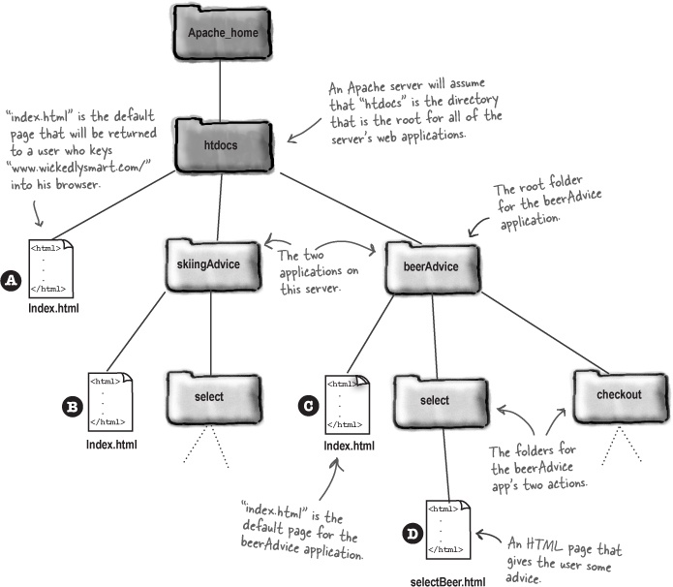

Slide 27

Mapping URLs to content
Look at the directory structure on the opposite page, then write in a URL that would get you to each of the four .html pages marked with the A, B, C, and D. We did the first one (A) for you, because that’s the kind of people we are. For the exercise, assume Apache is running on port 80. (The answers are at the bottom of the next page.) will cause the server to return to you the index.html page at location ?
image with no caption
will cause the server to return to you the index.html page at location
image with no caption
will cause the server to return to you the index.html page at location
image with no caption
will cause the server to return to you the index.html page at location
image with no caption
will cause the server to return to you the selectBeer.html page at location

Slide 28
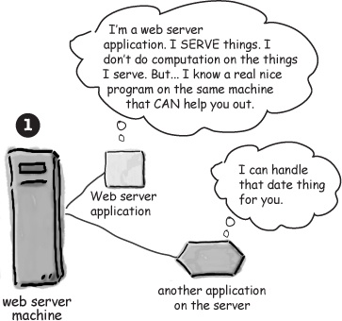
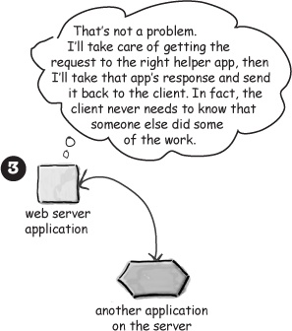

Slide 29
Two things the web server alone won’t do
If you need just-in-time pages (dynamically-created pages that don’t exist before the request) and the ability to write/save data on the server (which means writing to a file or database), you can’t rely on the web server alone.
1 Dynamic content
The web server application serves only static pages, but a separate “helper” application that the web server can communicate with can build non-static, just-in-time pages. A dynamic page could be anything from a catalog to a weblog or even just a page that randomly chooses pictures to display.
When instead of this:
<html>
<body>
The current time is
always 4:20 PM
on the server
</body>
</html>
<html>
<body>
The current time is
[insertTimeOnServer]
on the server
</body>
</html>
Just-in-time pages don’t exist before the request comes in. It’s like making an HTML page out of thin air.
The request comes in, the helper app “writes” the HTML, and the web server gets it back to the client.
2 Saving data on the server
When the user submits data in a form, the web server sees the form data and thinks, “So? Like I care?”. To process that form data, either to save it to a file or database or even just to use it to generate the response page, you need another app. When the web server sees a request for a helper app, the web server assumes that parameters are meant for that app. So the web server hands over the parameters, and gives the app a way to generate a response to the client.

Slide 30
CGI
The non-Java term for a web server helper app is “CGI” program
Most CGI programs are written as Perl scripts, but many other languages can work including C, Python, and PHP. (CGI stands for Common Gateway Interface, and we don’t care why it’s called that.)
Using CGI, here’s how it might work for a dynamic web page that has the current server date.
image with no caption

Slide 31
Servlet vs CGI (Common Gateway Interface)
Servlets can link directly to the Web server.
CGI cannot directly link to Web server.
Servlets can share data among each other.
CGI does not provide sharing property.
Servlets can perform session tracking and caching of previous computations.
CGI cannot perform session tracking and caching of previous computations.
Servlets are portable.
CGI is not portable.
In Servlets, the Java Virtual Machine stays up, and each request is handled by a lightweight Java thread
In CGI, each request is handled by a heavyweight operating system process.
Servlets automatically parse and decode the HTML form data.
CGI cannot automatically parse and decode the HTML form data.
Servlets can read and set HTTP headers, handle cookies, tracking sessions.
CGI cannot read and set HTTP headers, handle cookies, tracking sessions.
Servlets is inexpensive than CGI.
CGI is more expensive than Servlets

Slide 32
HTTP stands for Hypertext Transfer Protocol, and is the network protocol used on the Web. It runs on top of TCP/IP.
HTTP uses a request/response model—the client makes an HTTP request, and the web server gives back an HTTP response that the browser then figures out how to handle (depending on the content type of the response).
If the response from the server is an HTML page, the HTML is added to the HTTP response.
An HTTP request includes the request URL (the resource the client is trying to access), the HTTP method (GET, POST, etc.), and (optionally) form parameter data (also called the “query string”).
An HTTP response includes a status code, the content-type (also known as MIME type), and the actual content of the response (HTML, image, etc.)
A GET request appends form data to the end of the URL.
A POST request includes form data in the body of the request.
A MIME type tells the browser what kind of data the browser is about to receive so that the browser will know what to do with it (render the HTML, display the graphic, play the music, etc.)
URL stands for Uniform Resource Locator. Every resource on the web has its own unique address in this format. It starts with a protocol, followed by the server name, an optional port number, and usually a specific path and resource name. It can also include an optional query string, if the URL is for a GET request.
Web servers are good at serving static HTML pages, but if you need dynamically-generated data in the page (the current time, for example), you need some kind of helper app that can work with the server. The non-Java term for these helper apps (most often written in Perl) is CGI (which stands for Common Gateway Interface).
Putting HTML inside a println() statement is ugly and error-prone, but JSPs solve that problem by letting you put Java into an HTML page rather than putting HTML into Java code.

Slide 33
Download
JDK
STS
Tomcat
Mysql server
Mysql workbench

